Slide 1
SIGGRAPH
Meeting 03
Rasterization & Shading
PA2 & PA3
c7w
2021.11.20

Slide 2
The Graphics Pipeline
Object-order rendering: drawing objects one by one on the screen
(Consider each geometric object, find pixels it effects)
Rasterization: Finding the effected pixels of a geometric primitive(such as triangle)
Objects
Operations
Graphics Pipeline
Image
Notes:
首先回顾概念与做法
从图形管线的概念入手 回忆其中一些重要的操作
什么是渲染？从渲染的概念中引出图形管线。
渲染考虑的主题：Object-order, decompose objects into primitives. Then rasterize the primitives.

Slide 3
Graphics Pipeline
3
Application
1
4
Input: vertices in 3D space
2
Vertex
Processing
Vertex Stream
Vertices positioned in screen space
Triangle Processing
Triangle Stream
Triangles positioned in screen space
Rasterization
Fragment Stream
Fragments (one per covered sample)
Fragment Processing
Shaded Fragments
Shaded fragments
Framebuffer Operations
Display
Output: image (pixels)

Slide 4
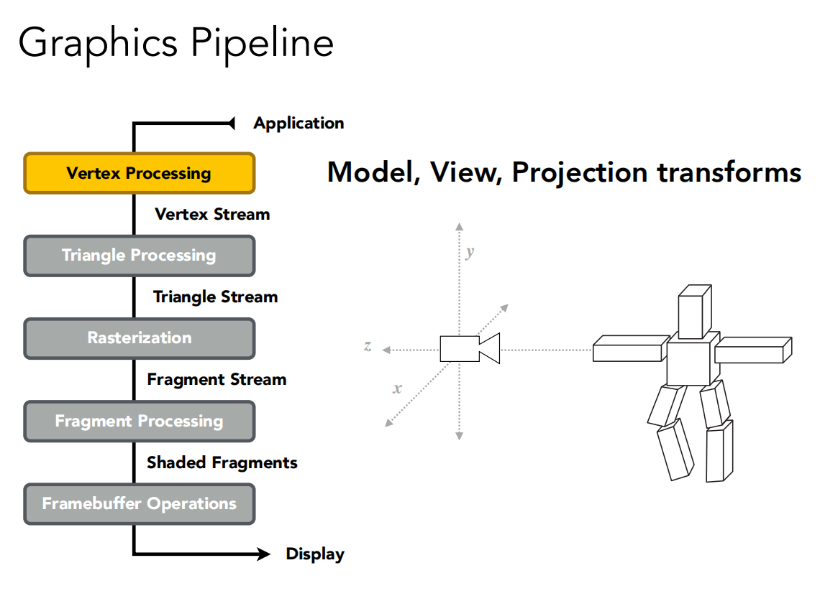
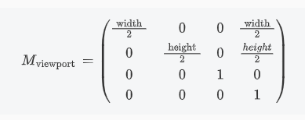
After MVP we could get a canonical cube [-1, 1]^3
Drop Z coordinate, then use Viewport Transformation
to map [-1, 1]^2 -> [0, W] x [0, H]

Slide 5
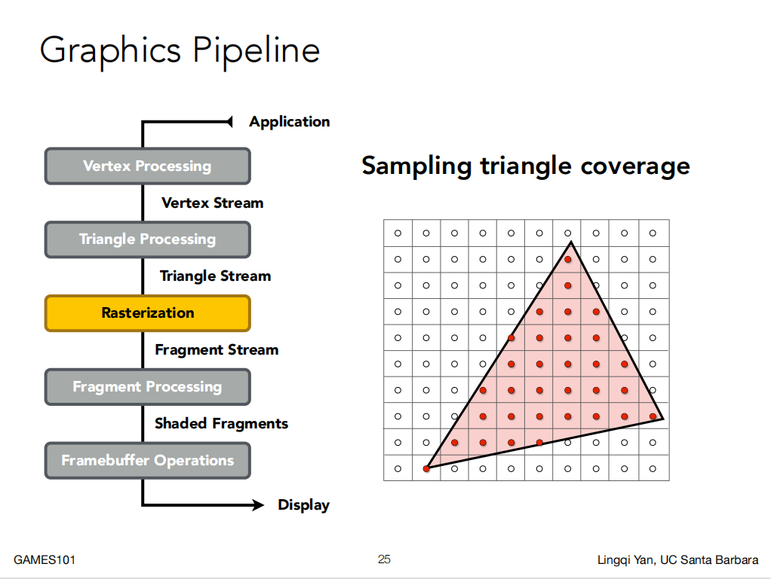
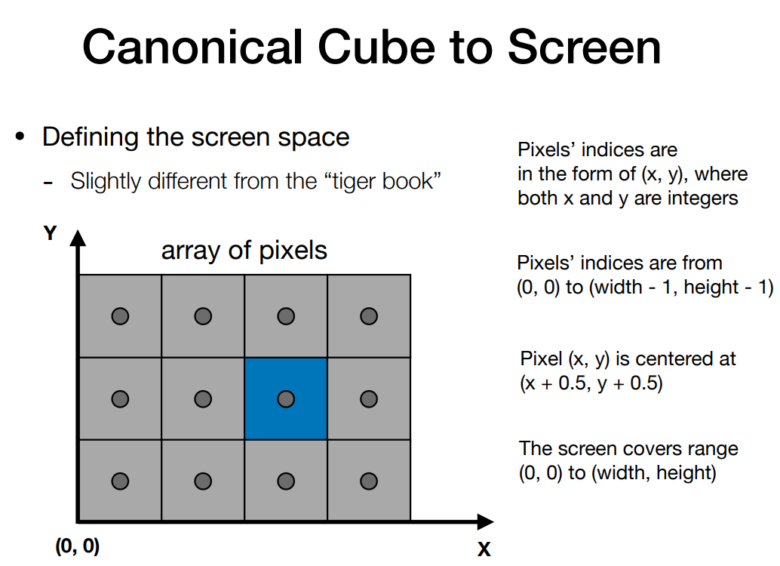
Notes:
首先定义屏幕：[0, w] x [0, h]
为什么选择三角形？因为三角形是最基础的多边形，任何其它多边形都可以用三角形来表示。同时，三角形的三个顶点一定在同一个平面内。三角形的内部和外部区分的十分清楚，而且可以用叉积来判断点是否在三角形中。

Slide 6
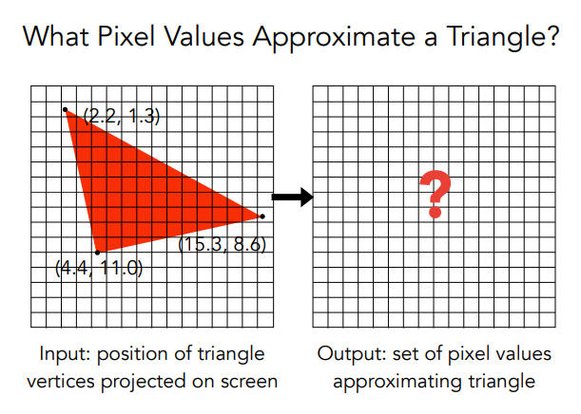
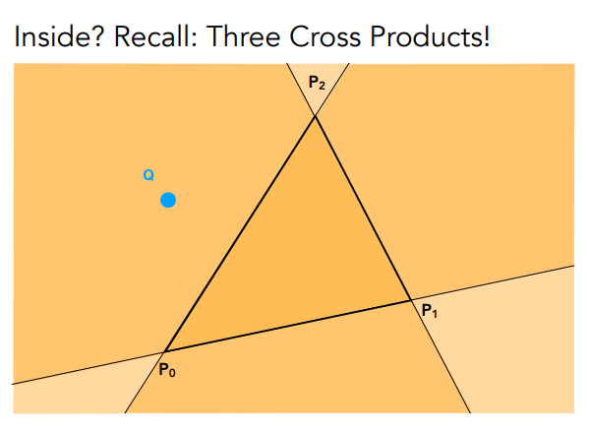
Notes:
光栅化：讲解 ToLeft 测试

Slide 7
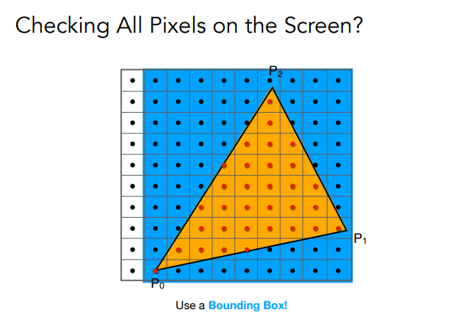
Notes:
讲解使用 Bounding Box 优化效率

Slide 8
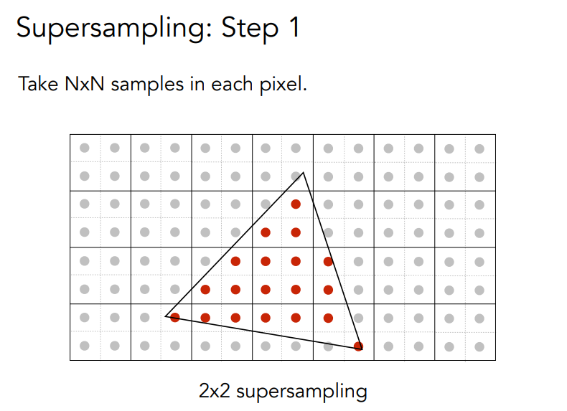
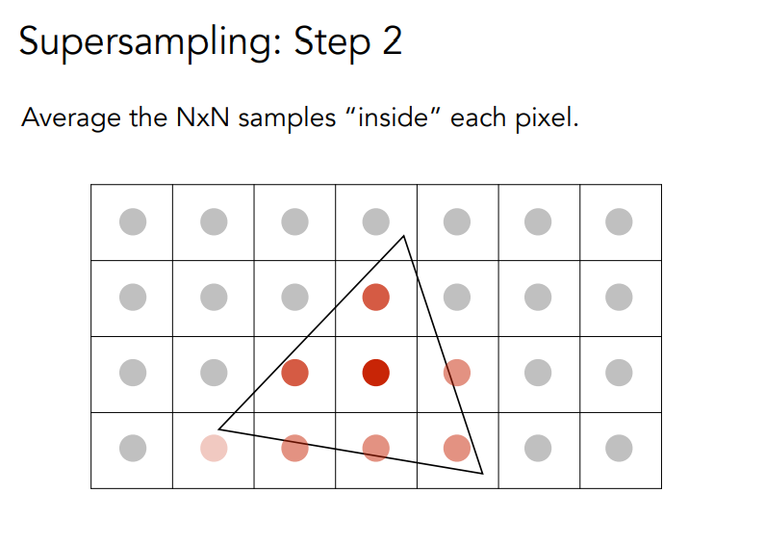
MSAA (Super Sampling)
Notes:
抗锯齿 by MSAA

Slide 9
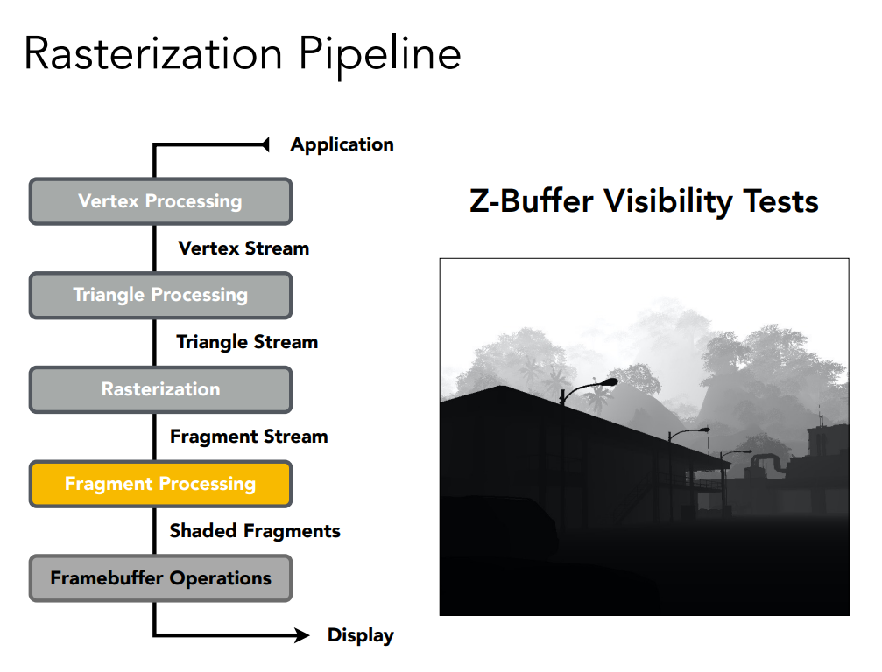
Z-buffering

Slide 10
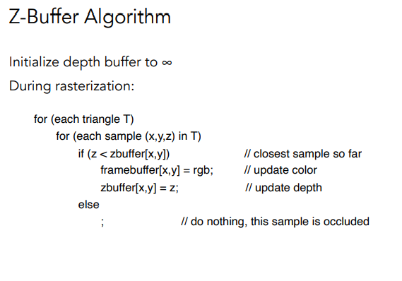
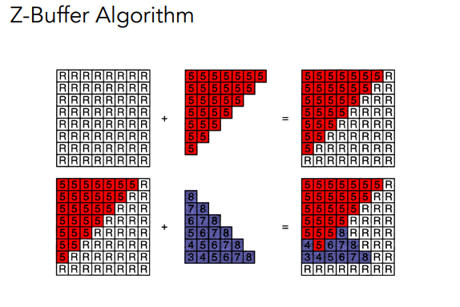

Slide 11
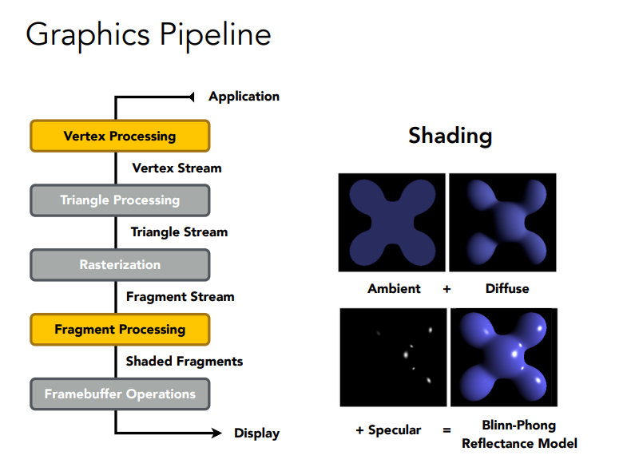

Slide 12
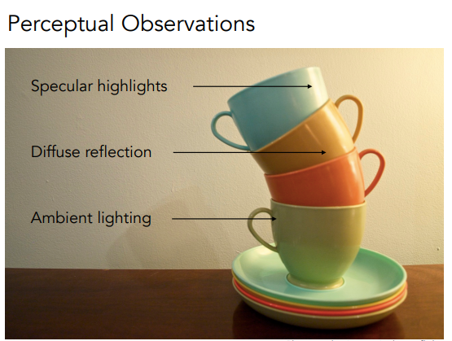
Blinn-Phong Reflectance Model

Slide 13
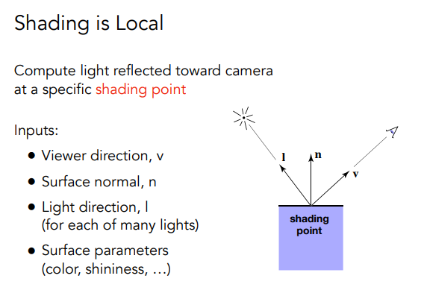
Definition

Slide 14
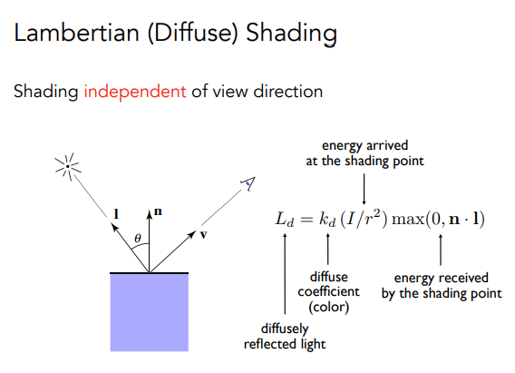
Diffuse
Light is scattered uniformly in all directions.
I’= I / r^2
Lambertian cosine law
Calculate received light by dot product

Slide 15
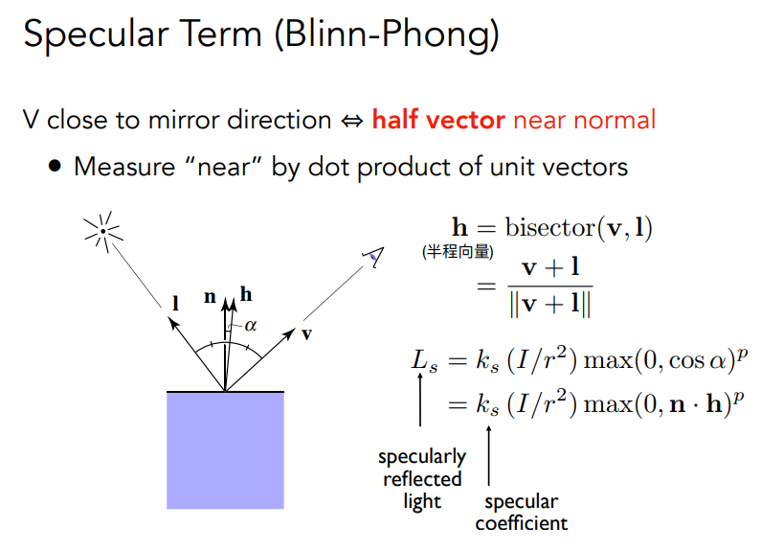
Specular

Slide 16
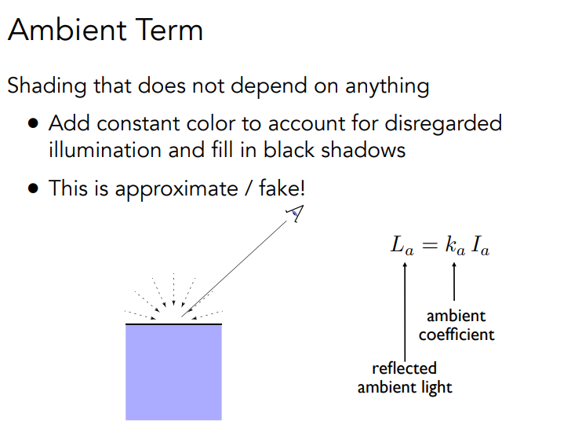
Ambient

Slide 17
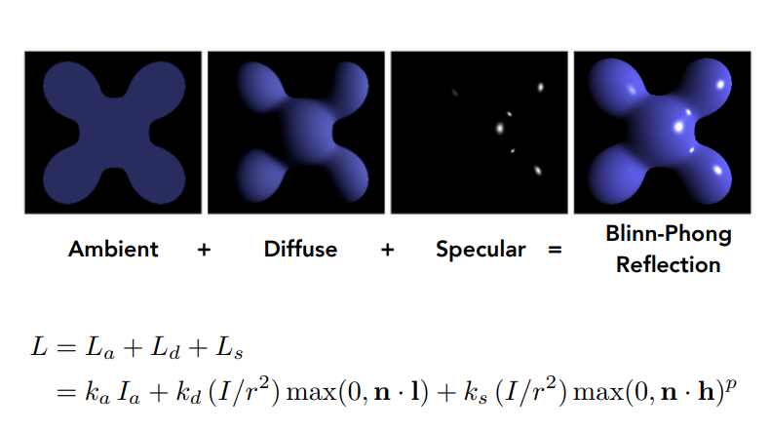
Blinn-Phong Reflection Model

Slide 18
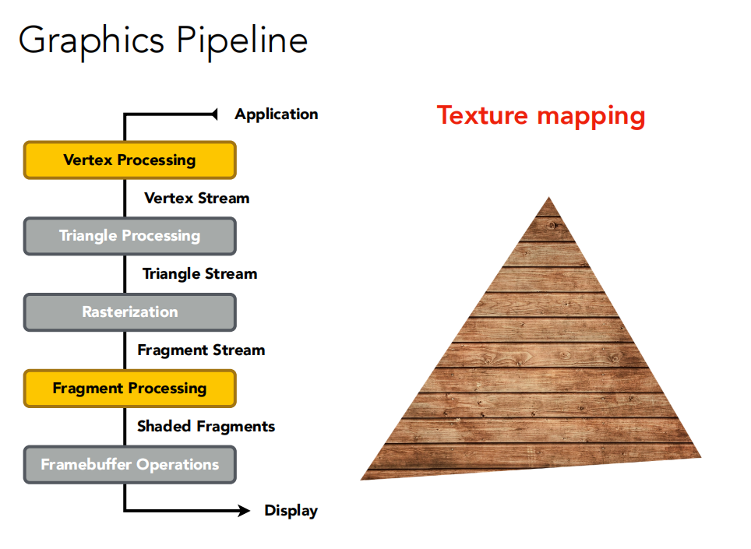

Slide 19
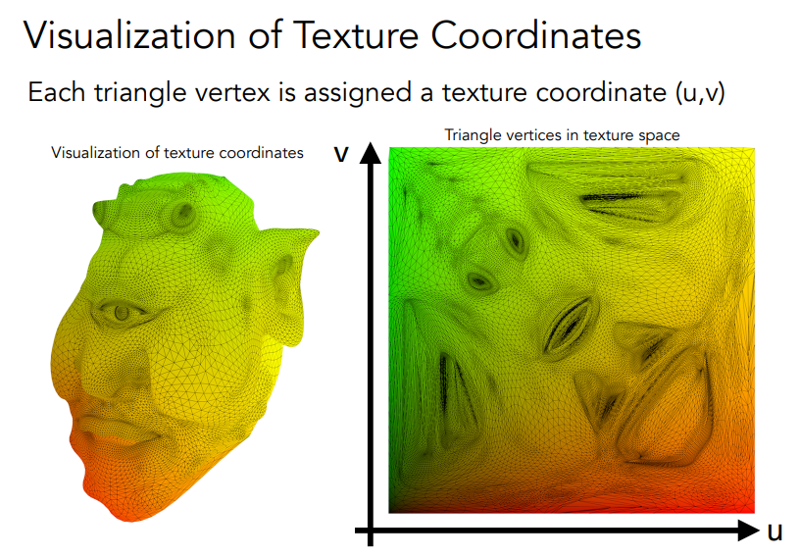

Slide 20
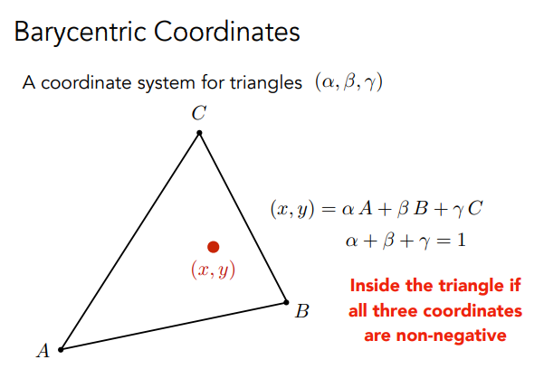
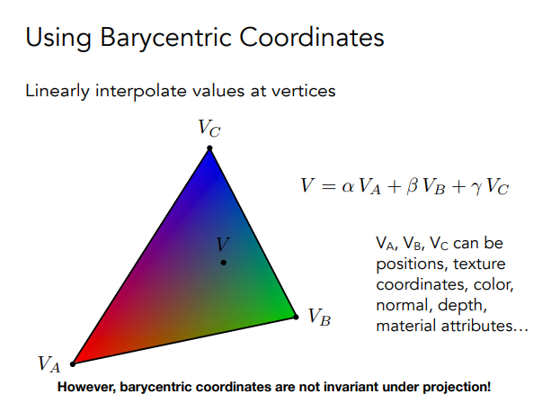
Interpolation: acquire smoothly varied values

Slide 21
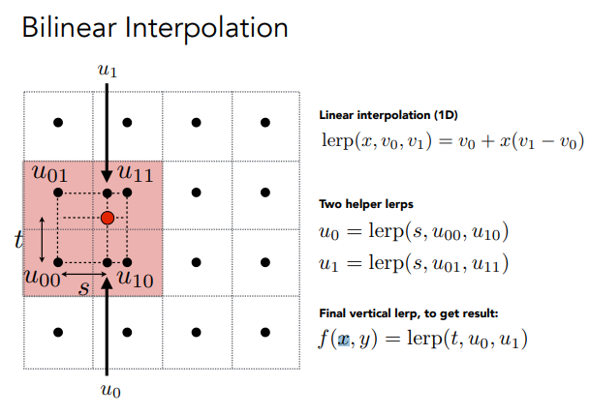
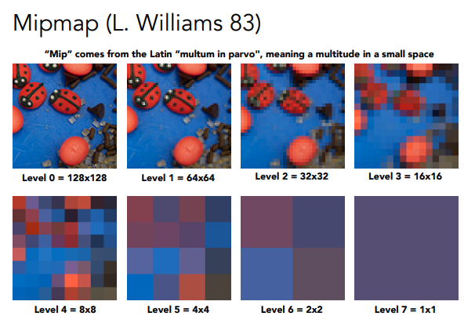
Applying Texture
材质图片过小：双线性插值
材质图片过大：Mipmap/各向异性过滤

Slide 22
PA2
PA2 要求我们实现将三角形光栅化的代码
同时要求我们实现 Z-buffering 的算法
使用 MSAA (多重采样抗锯齿)进行反走样
代码填空：
Find the bounding box
Test if certain point inside a given triangle
Update pixel values using Z-buffering
Super-sampling

Slide 23
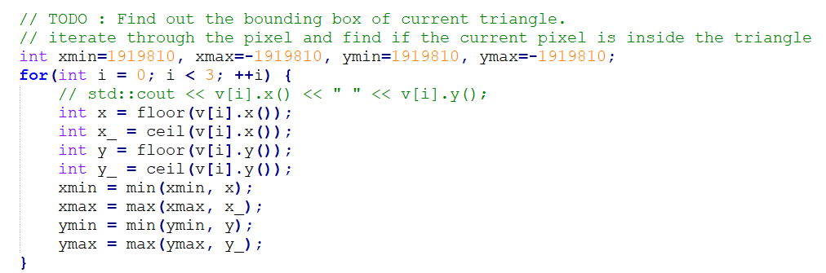
Find the bounding box
Given three number a, b, c, how to find the minimum/maximum of them?

Slide 24
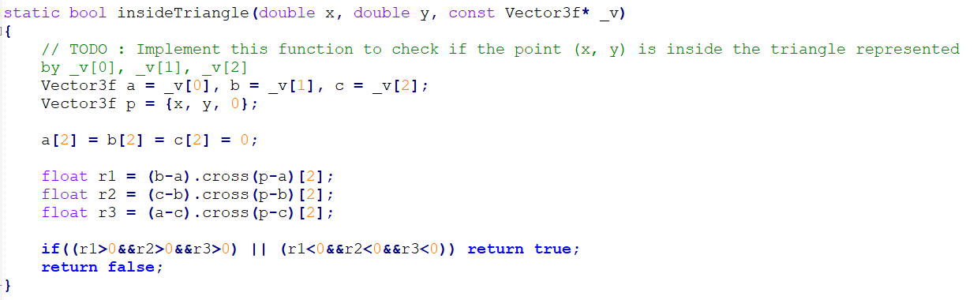
Test if certain point inside a given triangle
Use cross product, then test if the three results have the same sign.

Slide 25
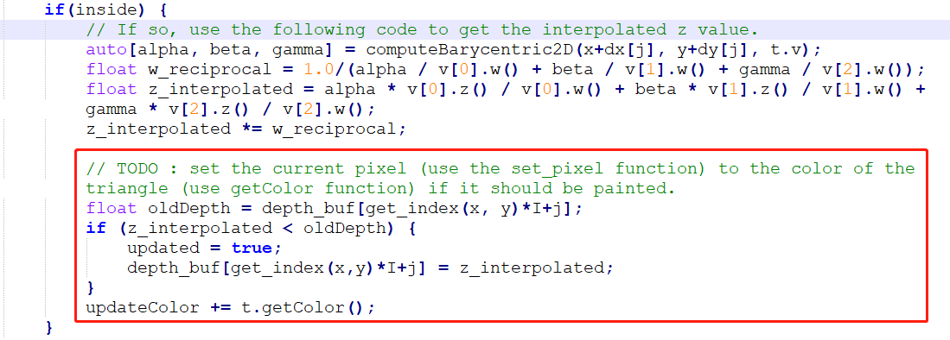
Update pixel values using Z-buffering
Seems like dynamic programming, update when there is a better choice.

Slide 26
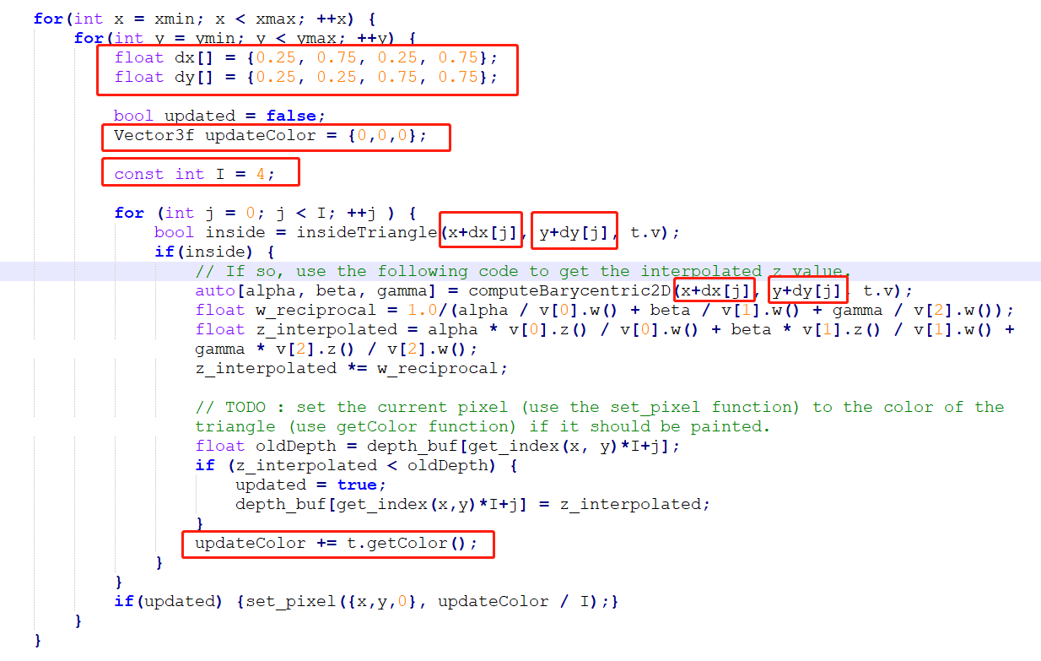
Supersampling
2x2 Supersampling, which means sample 4 times inside a single pixel.

Slide 27


Without MSAA
MSAA

Slide 28
PA3
PA3 要求我们实现重心坐标插值算法
Blinn-Phong 着色模型
应用材质，并考虑材质图片过小的情况（双线性插值）
Bump mapping & displacement mapping
代码填空：
Interpolation using Barycentric coordinates
Blinn-Phong Reflection Model (Diffuse, Specular, Ambient)
Using texture (u,v) as k_d; Bilinear interpolation
Try another model
Bump & displacement mapping (Implement according to the comment)

Slide 29
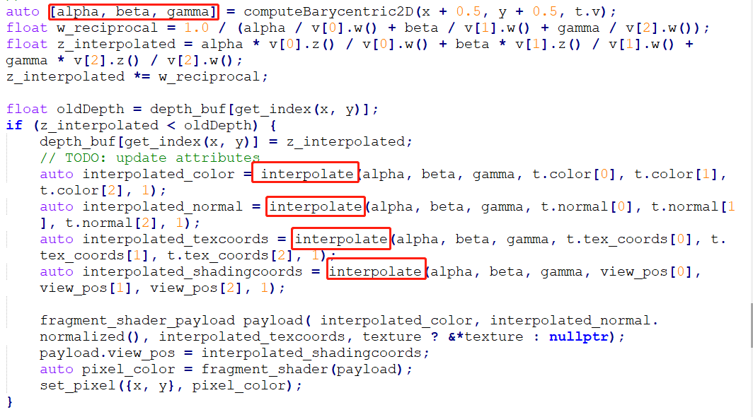
Interpolation using Barycentric coordinates

Slide 30
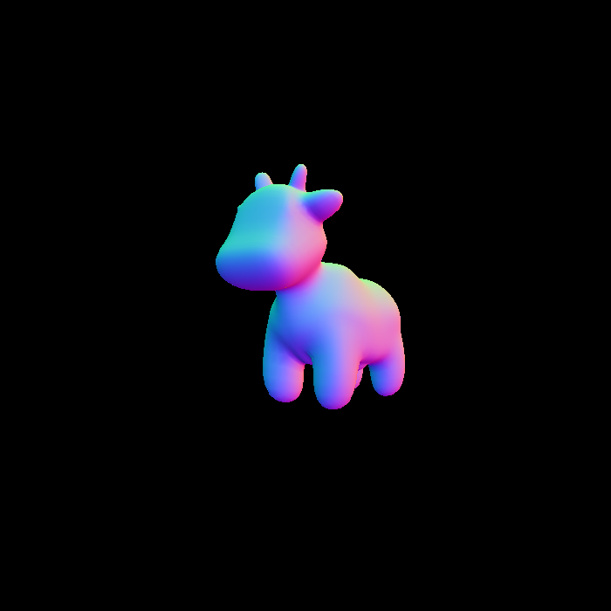
./Rasterizer output.png normal

Slide 31
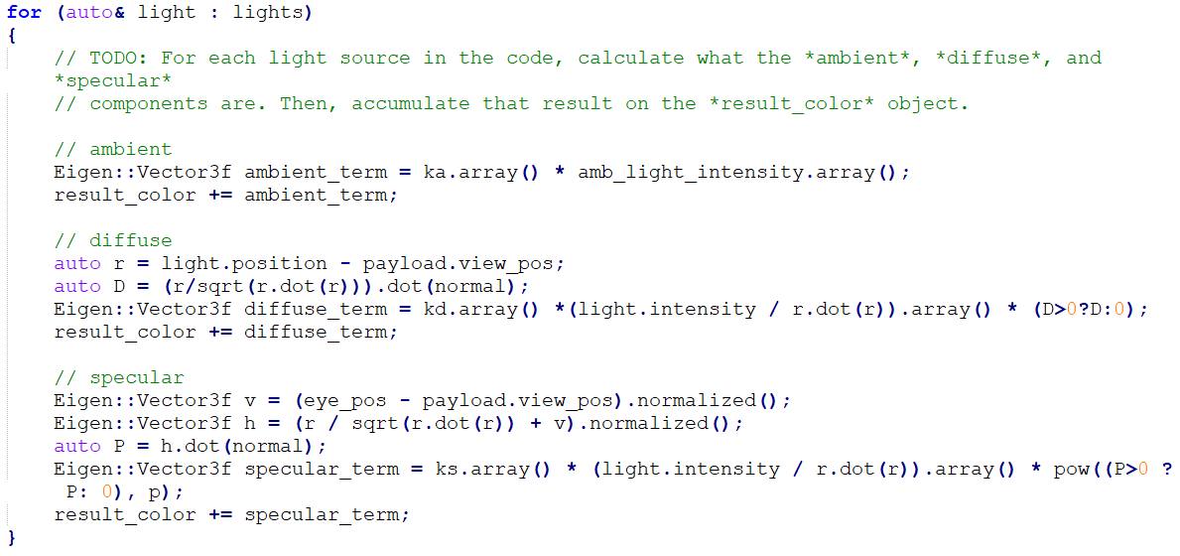
Blinn-Phong Reflection Model (Diffuse, Specular, Ambient)
For element-wise multiplication, you could use .array() or cwiseProduct()

Slide 32
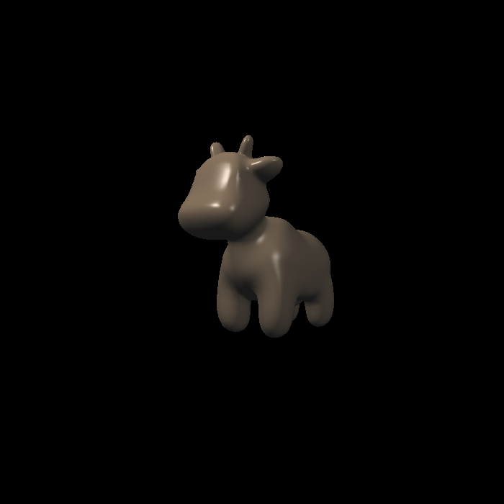
./Rasterizer output.png phong

Slide 33
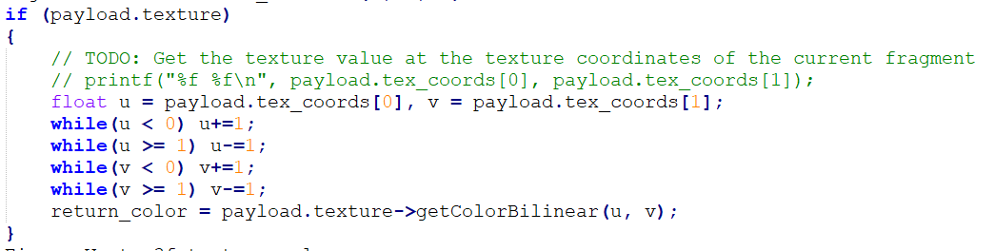
Using texture (u,v) as k_d
./Rasterizer output.png phong
Truncate u, v to [0, 1)

Slide 34
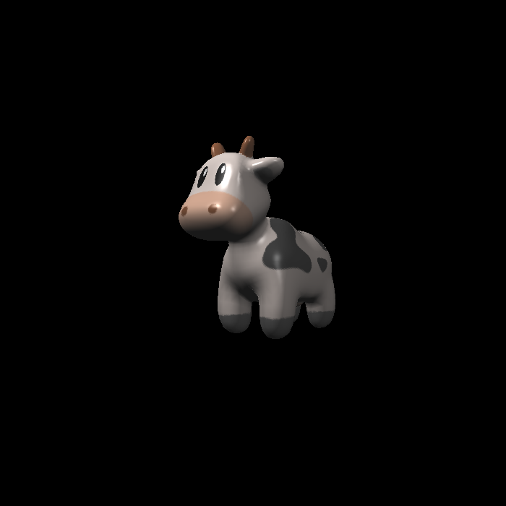
./Rasterizer output.png texture

Slide 35
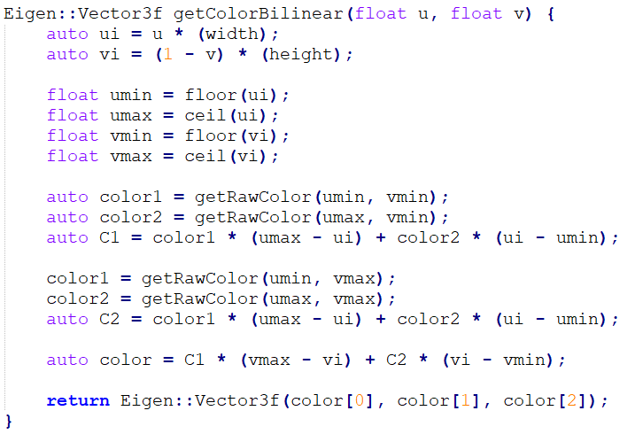
Bilinear interpolation
Be careful when interpolating!

Slide 36


./Rasterizer output.png texture
Shrink texture.png by 50%
Without bilinear interpolation
Bilinear interpolation

Slide 37
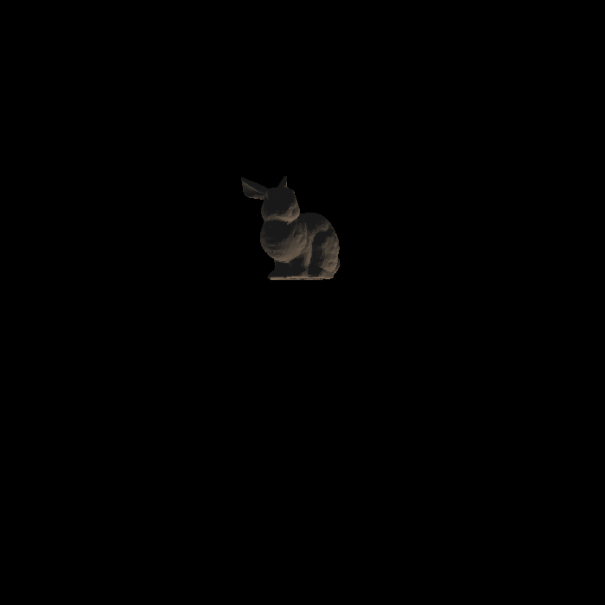
Try another model
Change the obj_path, load_path and text_path in main.cpp
Disable this line which could cause you segmentation fault :(
r.set_texture(Texture(obj_path + texture_path));
A little bunny that caused me segmentation fault for three times

Slide 38
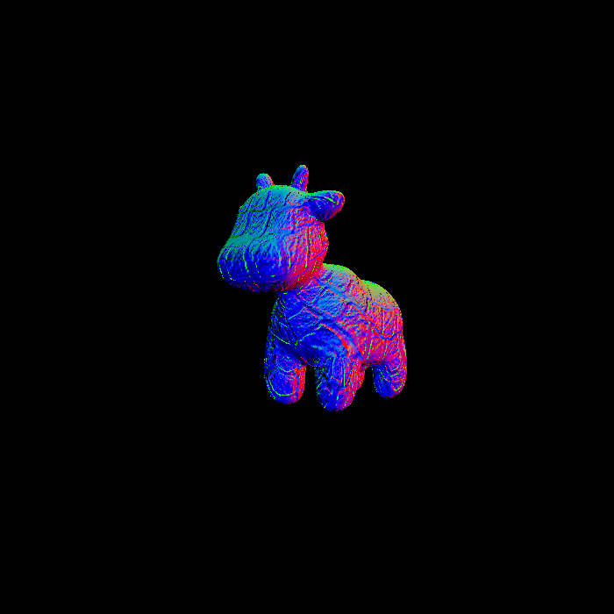
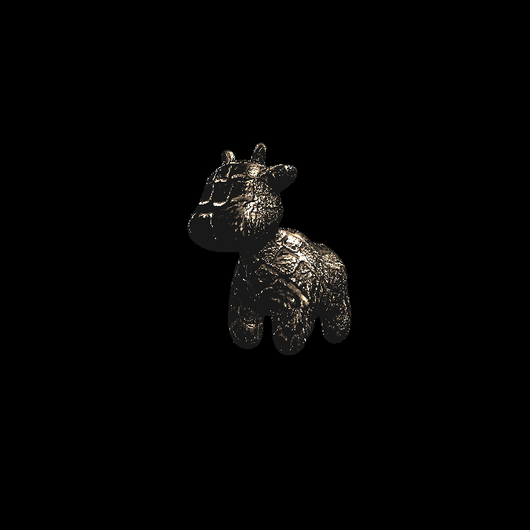
Bump & displacement mapping
./Rasterizer output.png bump
./Rasterizer output.png displacement
Just implement according to the comments.
Would be introduced later in Ray Tracing...
http://games-cn.org/forums/topic/frequently-asked-questionskeep-updating/

Slide 39
Thanks for listening!
c7w
2021.11.20
gha20@mails.tsinghua.edu.cn
admin@cc7w.cf

